Slide 1
Software development methodology – JIRA tool
Agile –Scrum method
Pauline Tristram / YggVal
Dec-2016

Slide 2
Three concept areas as of Software Development Plan
Process, Quality and Tools
PROCESS:
SAFE 4.0
Retrospective
Quality :
GAMP5
Scrum team
DoD
Validation Plan
Release
GxP
Poker planning
Requirements
SOP
Stand up
Validation Report
Review
IP Planning
Approval
Risk
NFRs
Workflow
Defect
Change
Sprint
Code
Test Plan
Testing
Test data
User Stories
Audit trail
Backlog
Test Environment
Traceability
Relationship
Item
Build
TOOLS: JAMA JIRA …
Baseline
Extract

Slide 3
Introduction

Slide 4
Using JAMA/JIRA
Software development tools
JAMA
Program Backlog:
EPIC
Capabilities
Features
User Stories
ART Planning
Sprint Planning
Ressource/Team allocation
Sprint Backlog completion
Sprint execution (development)
Code review
Unit testing
JIRA
Program Backlog update
Program Validation
Specifications reviews
Test execution
Fix and archive versions

Slide 5
Using JAMA/JIRA
Software development tools
JIRA overview
Step 1: How to login
Step 2 : set your dashboard
Step 3: Release Backlog transfered from JAMA
Step 4 : Sprint Planning
Step 5: Sprint execution
Step 6: Sprint Backlog Completion
Step 7: Release version and archive
Additional functionality : Reports

Slide 6
JIRA overview

Slide 7
JIRA Step by Step
JIRA overview
JIRA
Sprint Planning
Sprint 1
Sprint 2
…
JAMA
Program Backlog
User Stories
Release planning
Program Backlog definition
Sprint Execution
Sprint Backlog
User Stories
Functional Specifications
Design Specifications
Release validation and archiving

Slide 8
Step 1: How to login

Slide 9
JIRA Production URL link
How to login
http://dfwpjajira01.sial.com:8080/

Slide 10
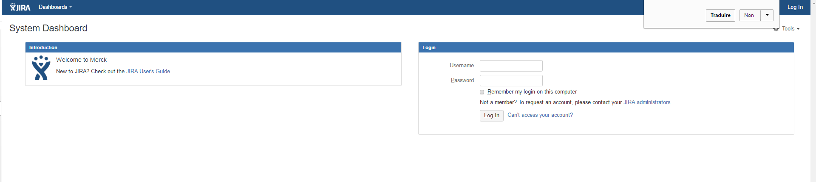
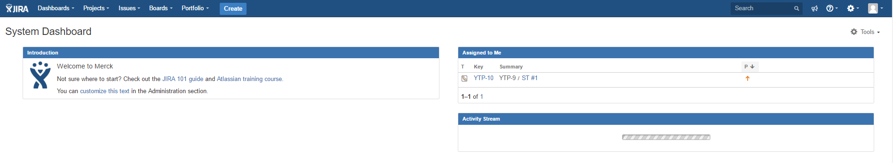
Login
How to login

Slide 11
Step 2 : set your dashboard

Slide 12
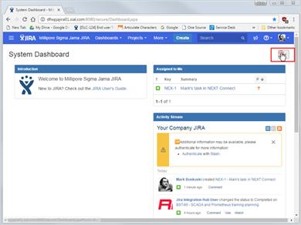
Configure your Dashboard
After you have logged in to JIRA, you can personalize your Dashboard to have a better view of your project evolution.
The JIRA Dashboard is a private view. When creating a Dashboard, by default it will not be visible for other users contrary to JAMA Dashboard.
You can edit, delete, copy, mark favorites, and share your dashboards from the Manage Dashboards page.

Slide 13
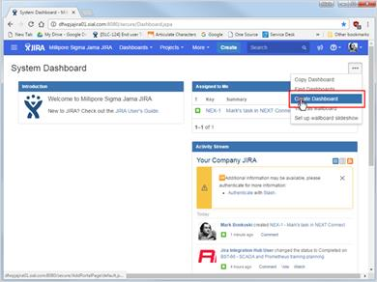
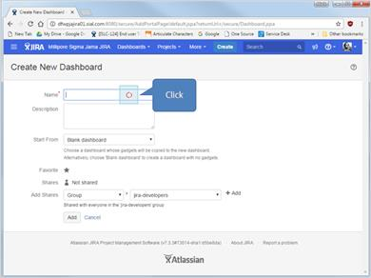
Configure your Dashboard
Create your proper Dashboard

Slide 14
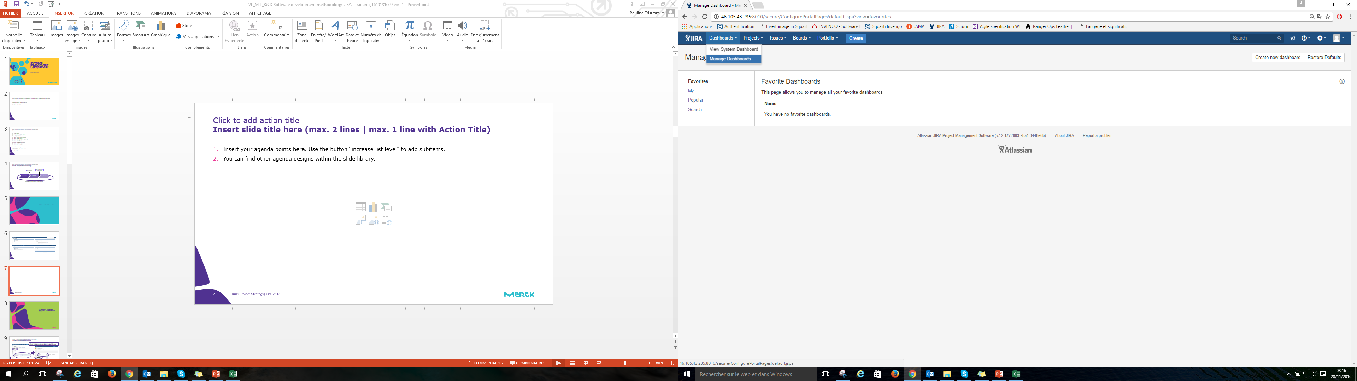
Configure your Dashboard
Or select an existing Dashboard that shall be displayed at login

Slide 15
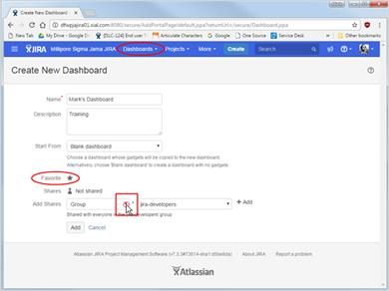
Configure your Dashboard
For your dashboard to appear on the Dashboards pull down menu, you must have it selected as a Favorite as shown here.
Now, as we mentioned earlier your dashboard by default is not shared with anyone else. You may change that if you like by clicking the drop-down list icon in the Add Shares field…

Slide 16
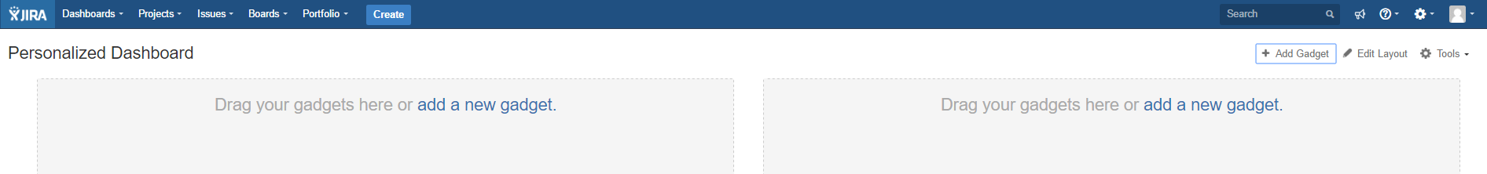
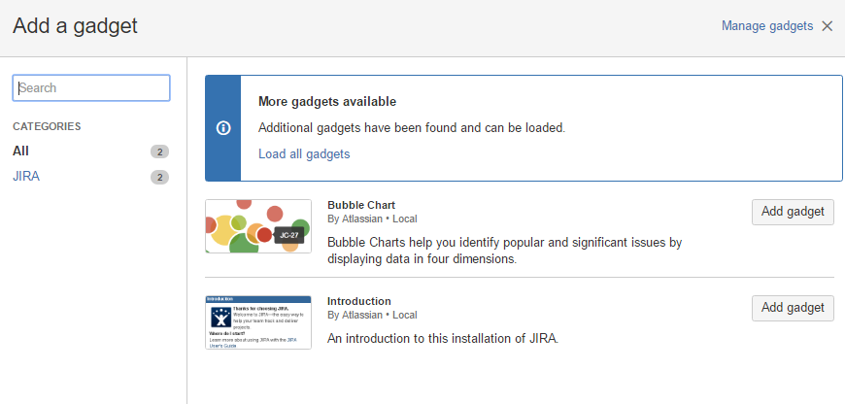
Configure your Dashboard
Gadgets are pre-configured reports designed to make analyzing the progress of your projects transparent.
So here we see only a few gadgets.
The system instantly adds the gadget to your dashboard with current information.
You may add more gadgets by clicking the Add gadget button.

Slide 17
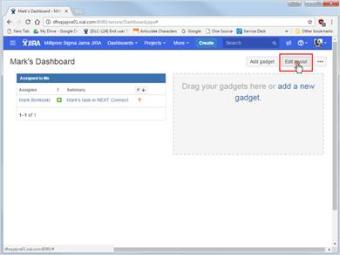
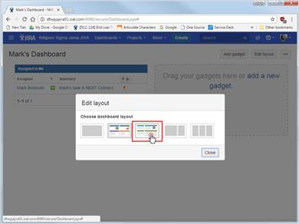
Configure your Dashboard
s
You may also change the layout of your dashboard

Slide 18
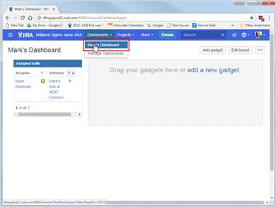
Configure your Dashboard
You also have access to your Dashboard through the Dashboard menu

Slide 19
Step 3: Release Backlog transfered from JAMA

Slide 20
JIRA Step by Step
JIRA overview
JIRA
Sprint Planning
Sprint 1
Sprint 2
…
JAMA
Program Backlog
User Stories
Release planning
Program Backlog definition
Sprint Execution
Sprint Backlog
User Stories
Functional Specifications
Design Specifications
Release validation and archiving

Slide 21
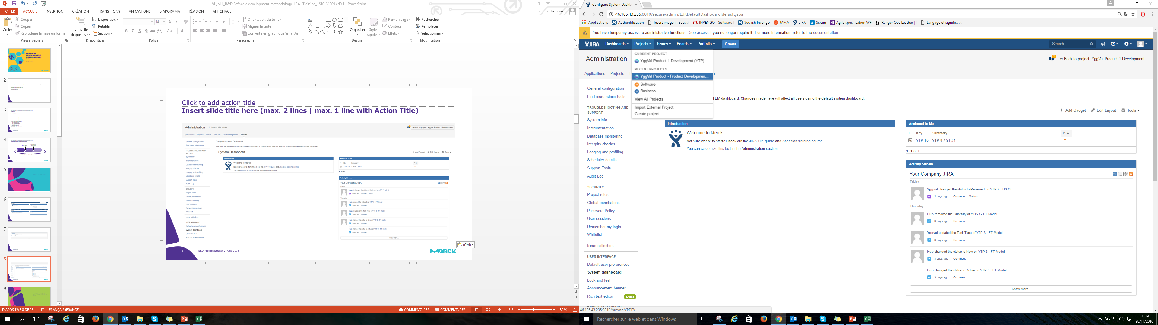
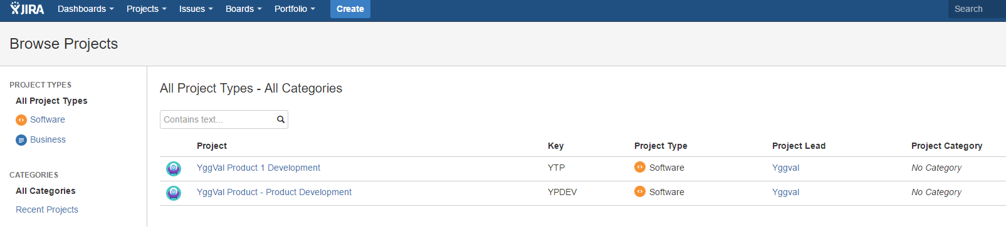
Open Project
Release Backlog transfered from JAMA

Slide 22
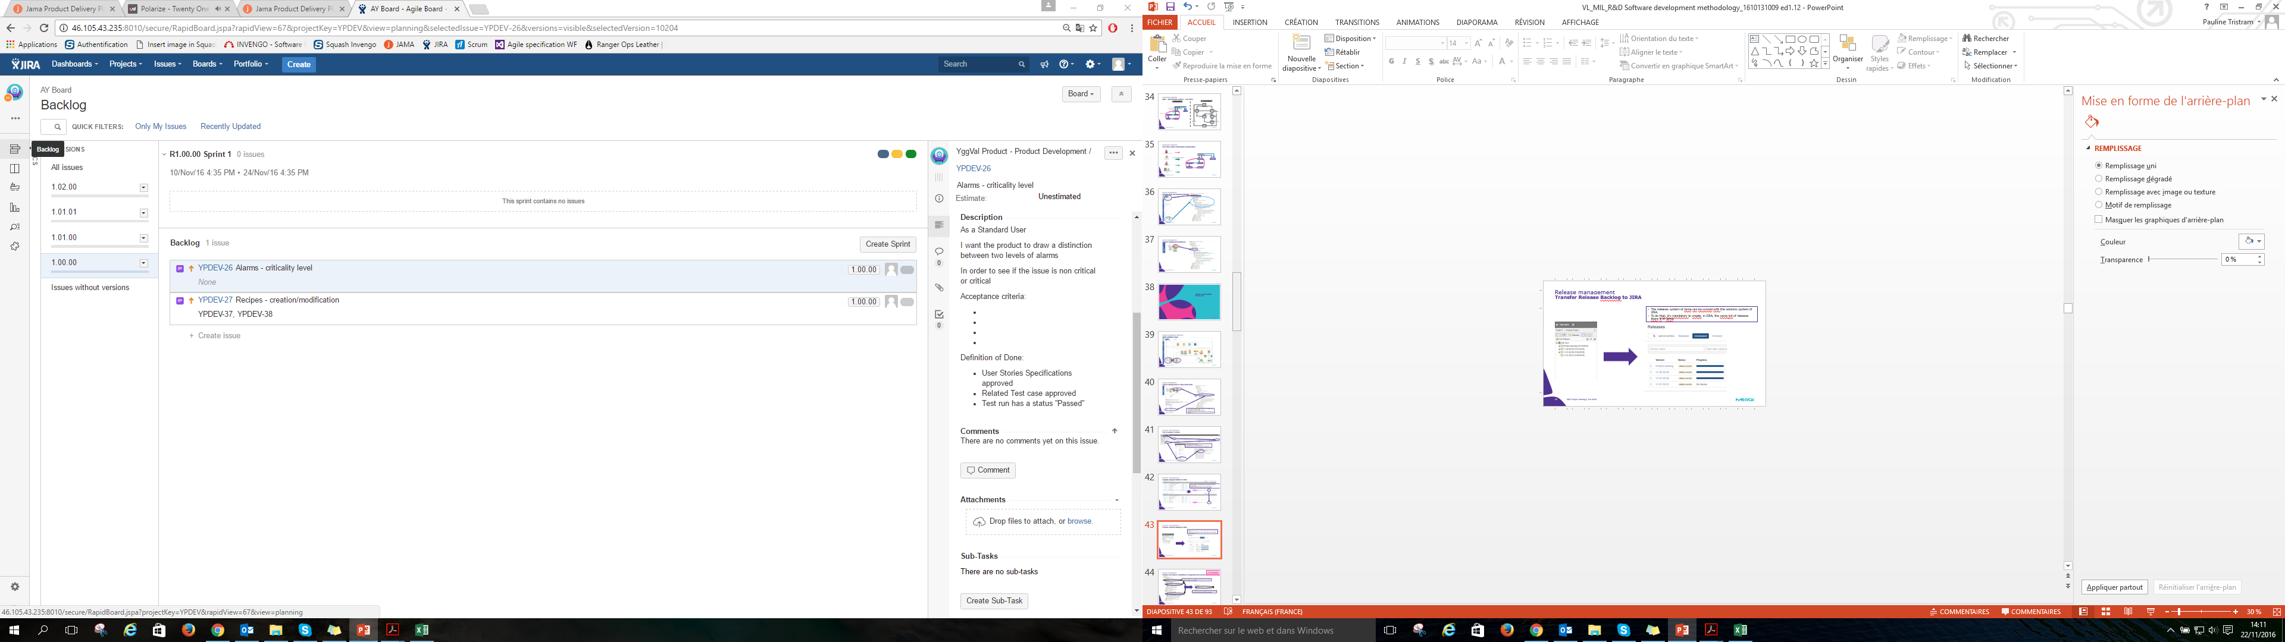
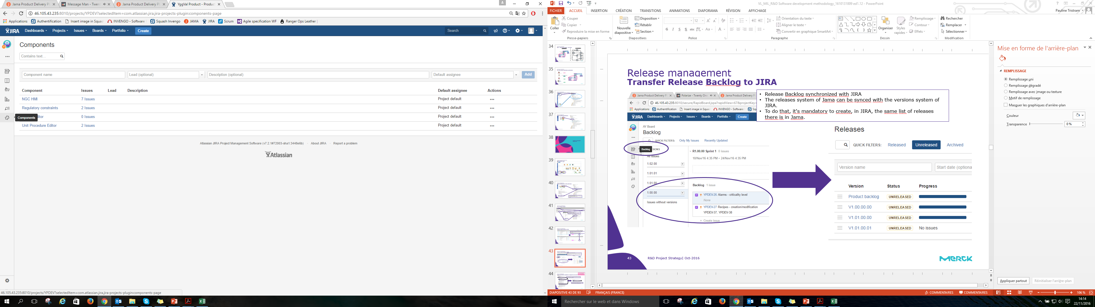
Release Backlog transfered from JAMA
Release Backlog
Release Backlog synchronized with JIRA
The releases system of Jama can be synced with the versions system of JIRA
To do that, it's mandatory to create, in JIRA, the same list of releases there is in Jama
User Stories organized by components as per JAMA (Component fields synchronization)

Slide 23
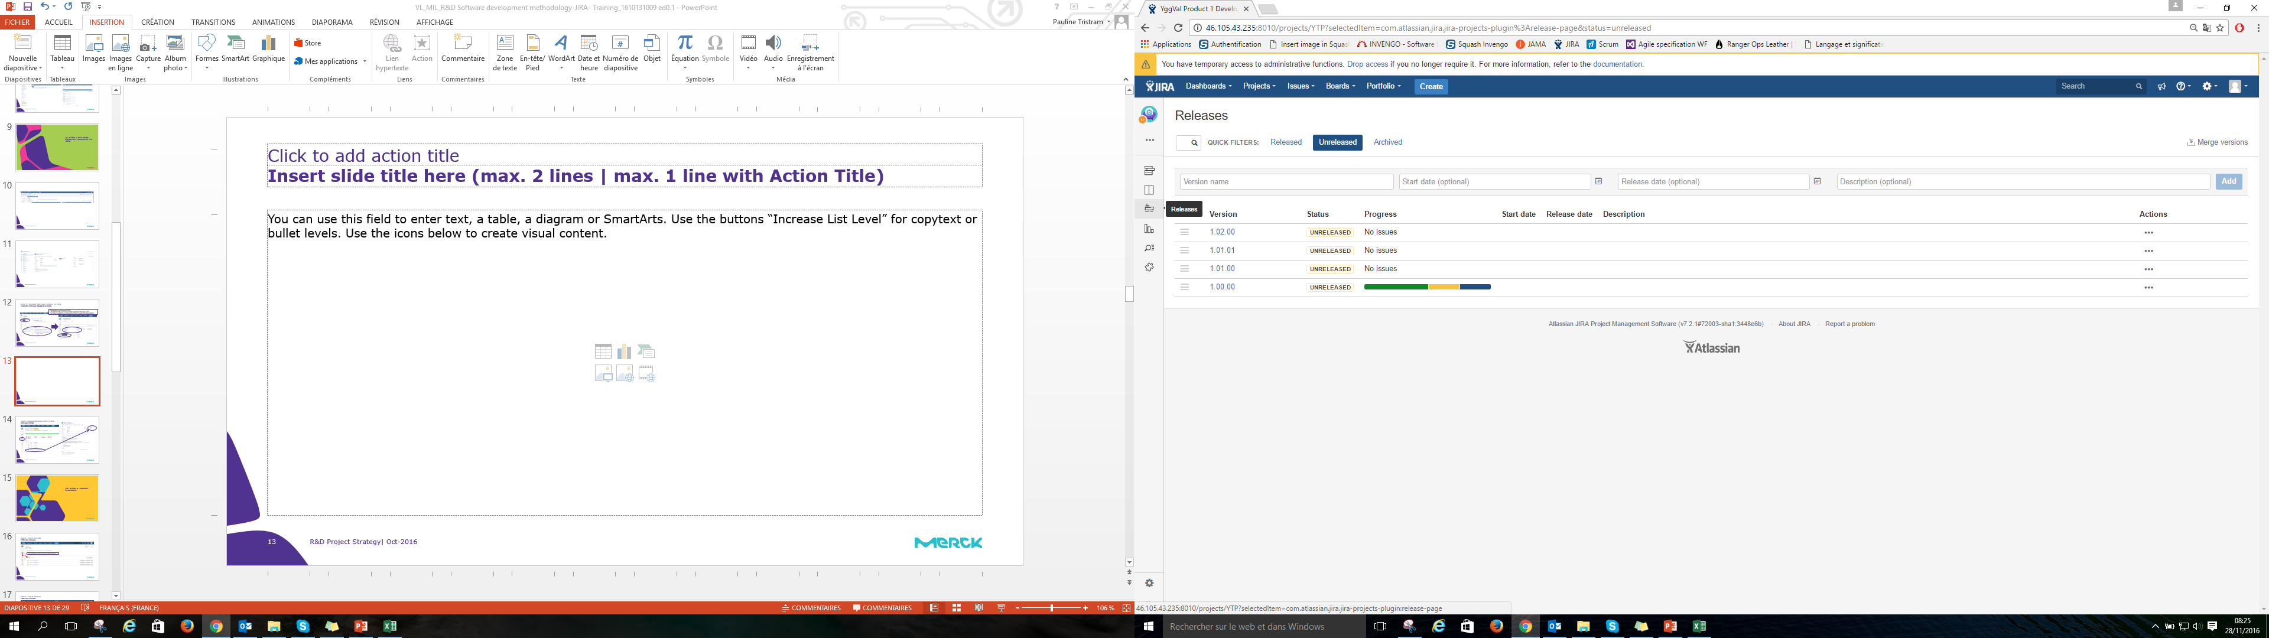
Release planning
Release Backlog transfered from JAMA
Have an overview of your Products versions

Slide 24
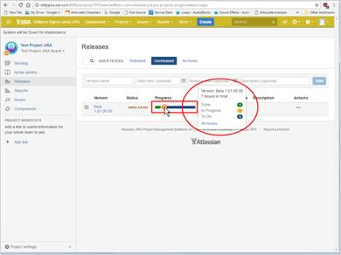
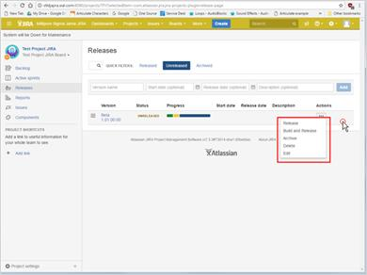
Release planning
Release Backlog transfered from JAMA
Have an overview of your versions progressions
Be able to manage version’s statuses

Slide 25
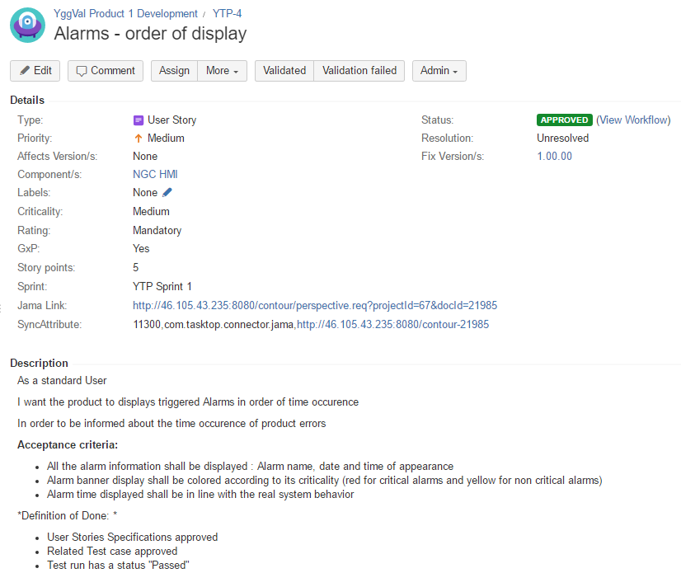
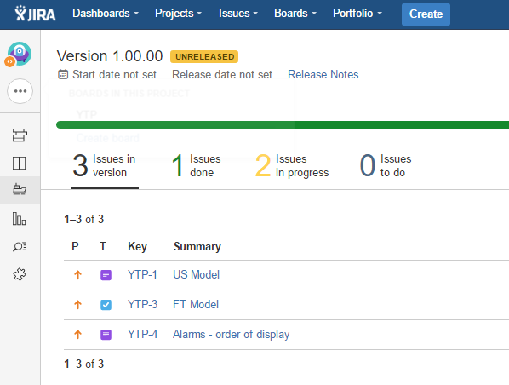
Release details
Release Backlog transfered from JAMA
Release Backlog organized by status
Recovers User Stories synchronized fields and description from JAMA

Slide 26
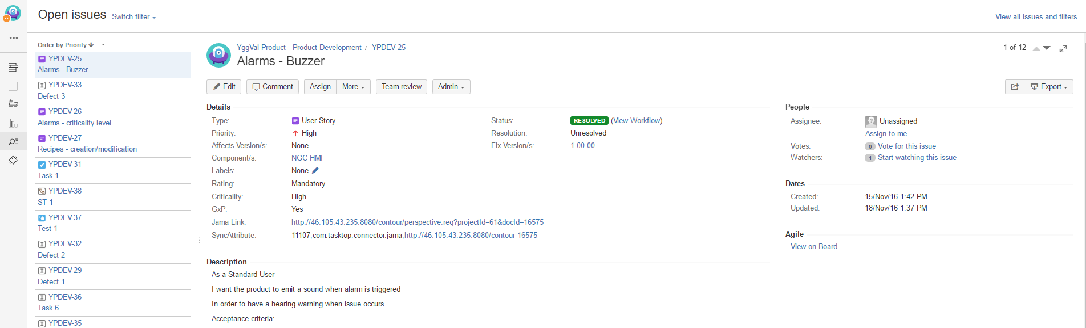
Opened issues
Release Backlog transfered from JAMA
Quick search of items by specific filters
List of all issues not yet released

Slide 27
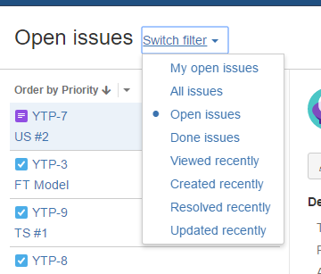
Search by filter
Release Backlog transfered from JAMA

Slide 28
Step 4 : Sprint Planning

Slide 29
JIRA Step by Step
JIRA overview
JIRA
Sprint Planning
Sprint 1
Sprint 2
…
JAMA
Program Backlog
User Stories
Release planning
Program Backlog definition
Sprint Execution
Sprint Backlog
User Stories
Functional Specifications
Design Specifications
Release validation and archiving

Slide 30
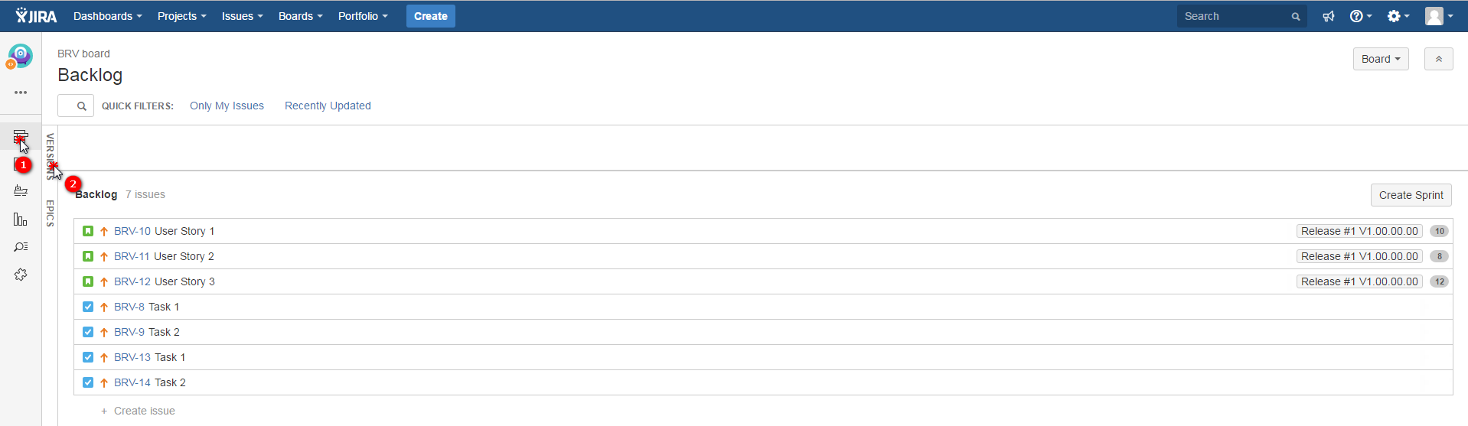
Filter by Release
Sprint Planning
Sprint planning is created through the Release Backlog

Slide 31
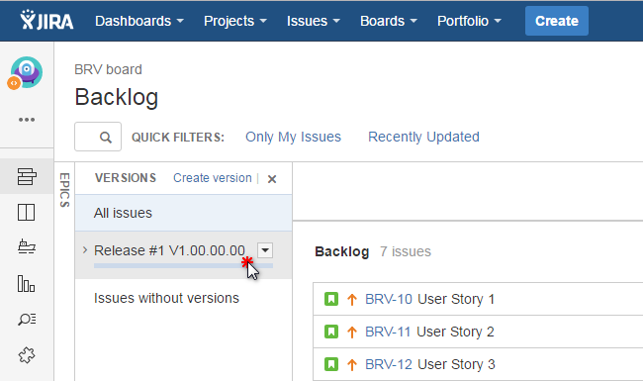
Filter by Release
Sprint Planning

Slide 32
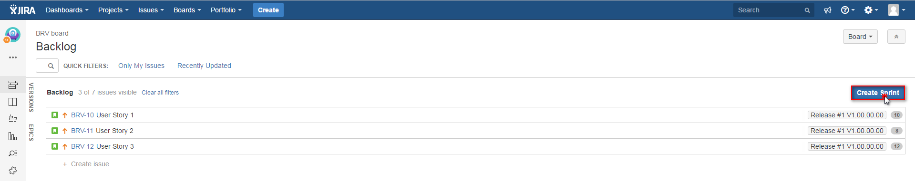
Release Backlog - New Sprint
Sprint Planning
Create the list of planned Sprint

Slide 33
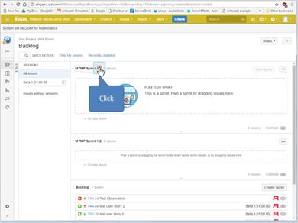
Release Backlog - New Sprint
Sprint Planning
Edit Sprint name if needed

Slide 34
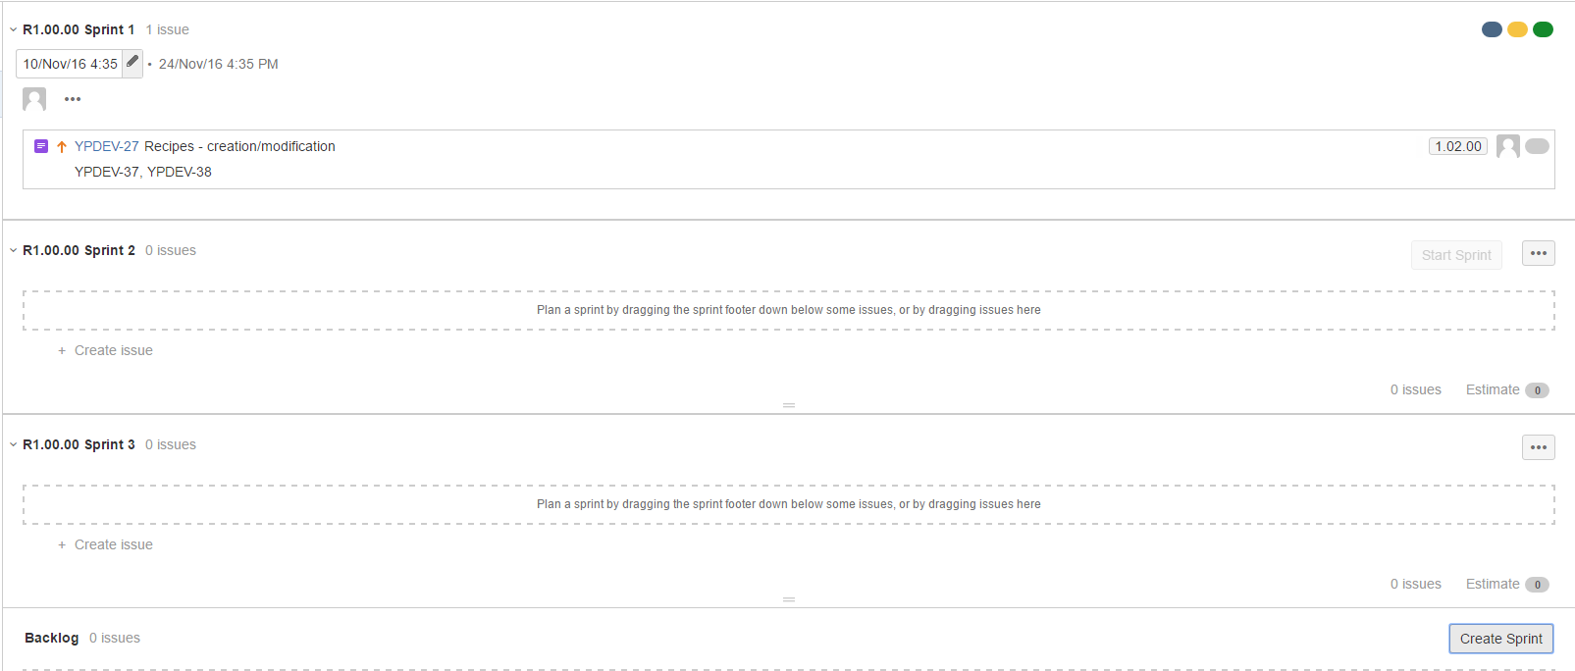
Release Backlog – Sprint list
Sprint Planning

Slide 35
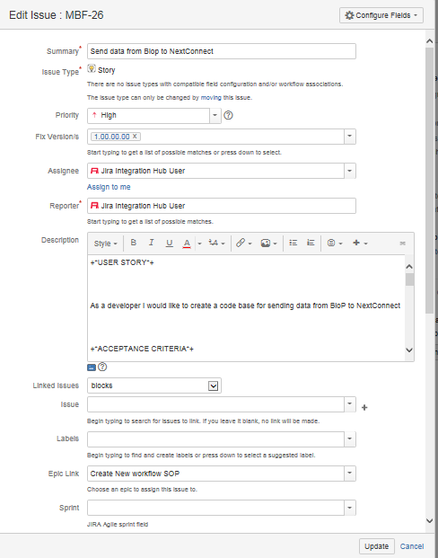
Plan User Stories Sprint
Sprint Planning
Before starting sprint : Make sure User stories properties are defined

Slide 36
Step 5: Sprint execution

Slide 37
JIRA Step by Step
JIRA overview
JIRA
Sprint Planning
Sprint 1
Sprint 2
…
JAMA
Program Backlog
User Stories
Release planning
Program Backlog definition
Sprint Execution
Sprint Backlog
User Stories
Functional Specifications
Design Specifications
Release validation and archiving

Slide 38
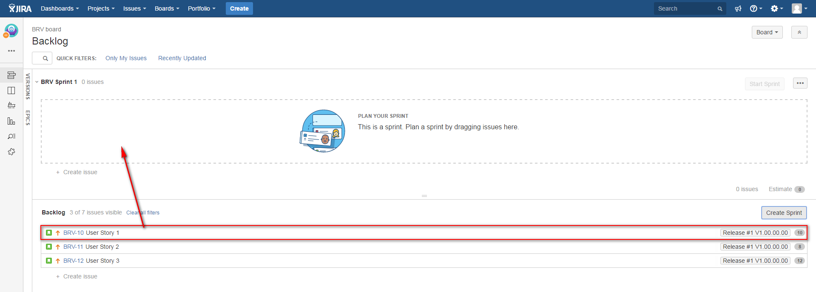
Put item in the Sprint
Sprint execution
Transfer items to corresponding Sprint section
Drag & Drop
items

Slide 39
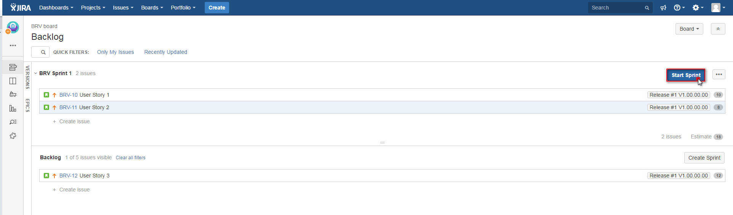
Start a Sprint
Sprint execution

Slide 40
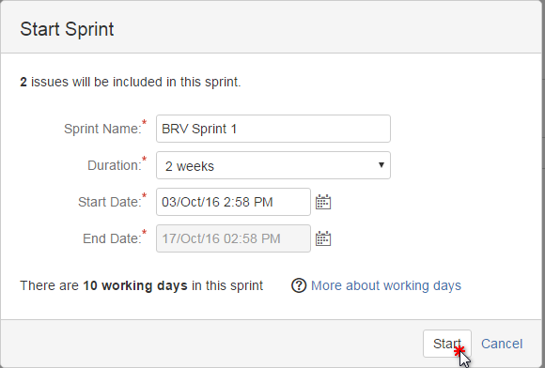
Define Sprint
Sprint execution

Slide 41
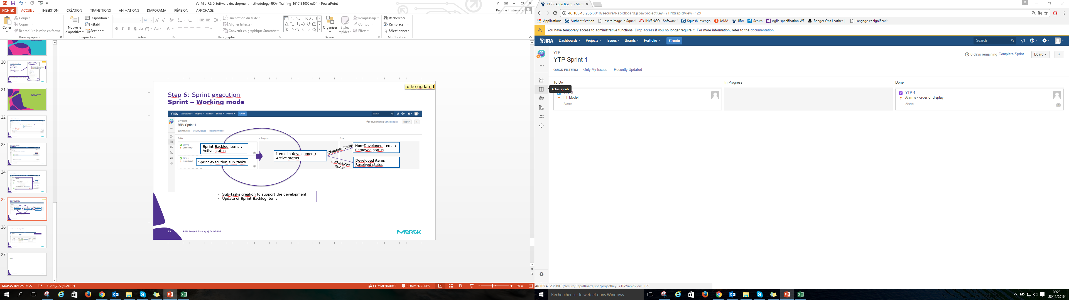
Sprint – Working mode
Sprint execution

Slide 42
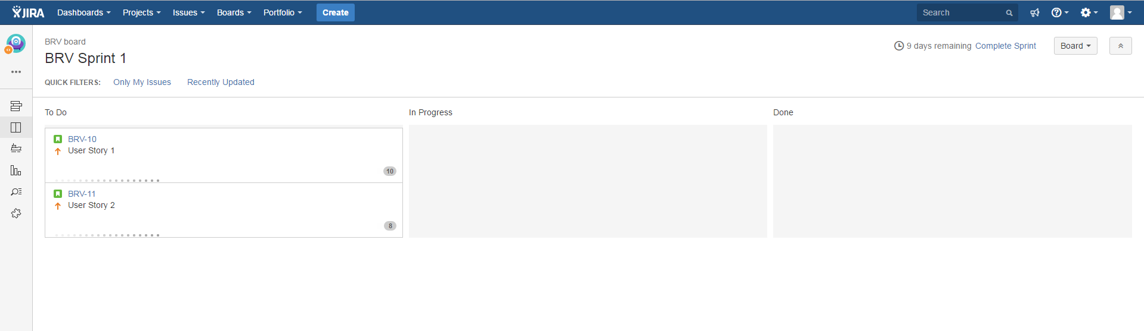
Sprint – Working mode
Sprint execution
Sprint Backlog User Stories and Tasks
Items in development
Completed items
Sprint execution Tasks/Sub-tasks
Tasks/ Sub-Tasks creation to support the development
Update of Sprint Backlog items

Slide 43
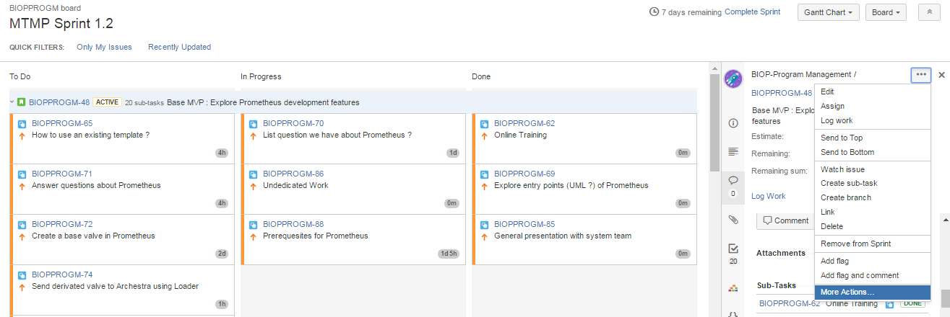
Log your work
Sprint execution
Concern items that are in an active Sprint
You can log your work progression for each item

Slide 44
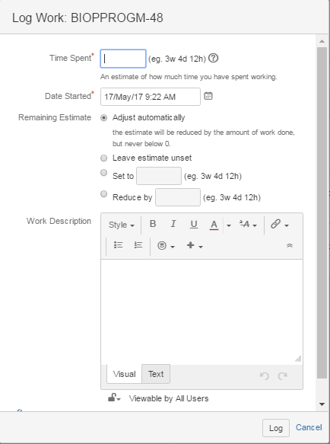
Log your work
Sprint execution
Define the time Spent each day on your task
Define the day you started your work and the remaining estimate work to complete the task

Slide 45
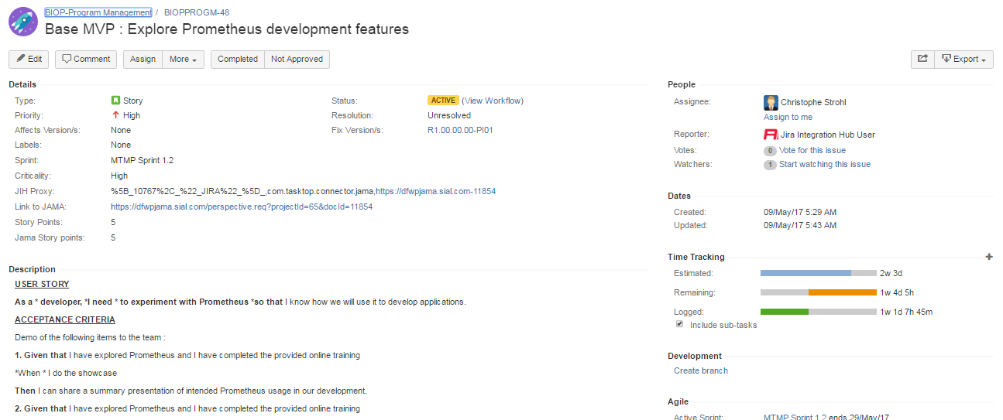
Log your work
Sprint Backlog definition

Slide 46
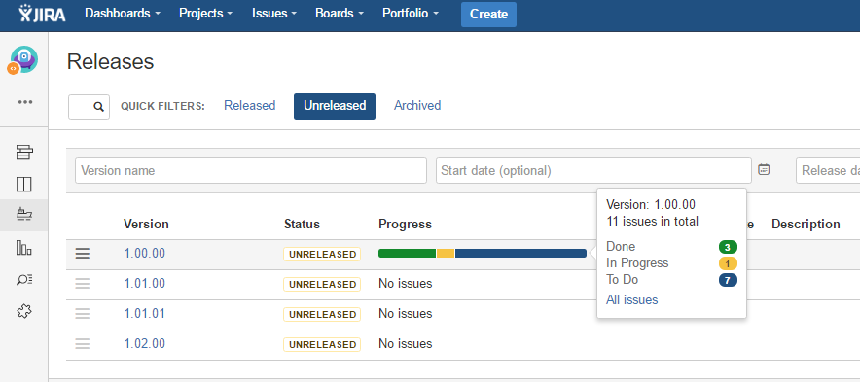
Sprint execution
Release progression overview
Have a global overview of your version progression
Take in account items statuses

Slide 47
Step 6: Sprint Backlog Completion

Slide 48
JIRA Step by Step
JIRA overview
JIRA
Sprint Planning
Sprint 1
Sprint 2
…
JAMA
Program Backlog
User Stories
Release planning
Program Backlog definition
Sprint Execution
Sprint Backlog
User Stories
Functional Specifications
Design Specifications
Release validation and archiving

Slide 49
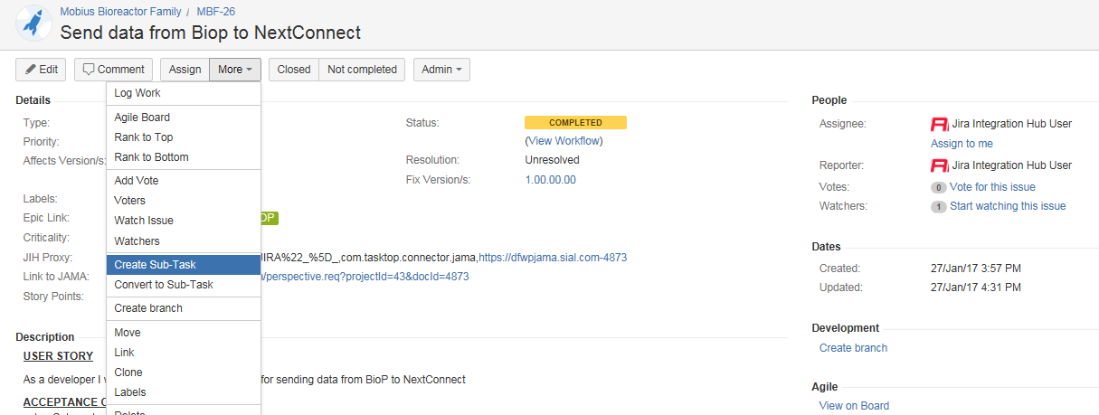
Complete Backlog
Sprint Backlog completion
Each developer will detail Program Increment User Story
Sub task creation linked to the US
Can be created directly through the User Story detailed view

Slide 50
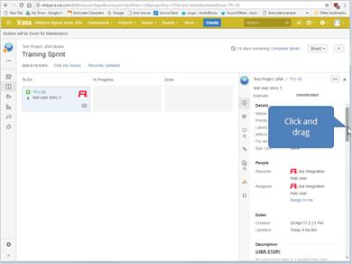
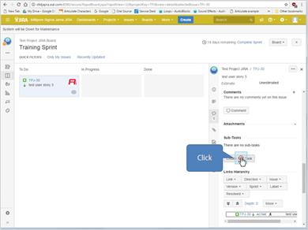
Complete Backlog
Sprint Backlog completion
Or during Sprint execution

Slide 51
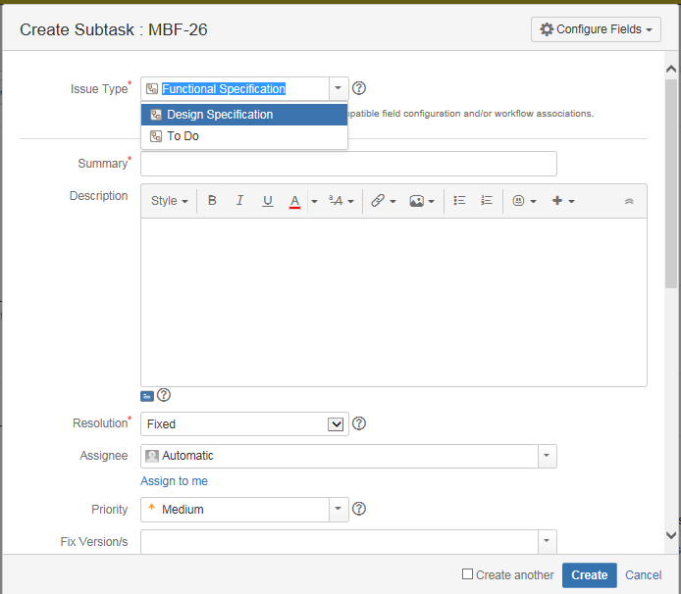
Create Sub-Tasks
Sprint Backlog completion
Define the Sub-Task into:
To do : Working Tasks
Functional Specification : Quality artifact transferred to JAMA that defines the User Story related functionalities
Design Specification : Quality artifact transferred to JAMA that defines the User Story related technical details
Link build automatically with the US

Slide 52
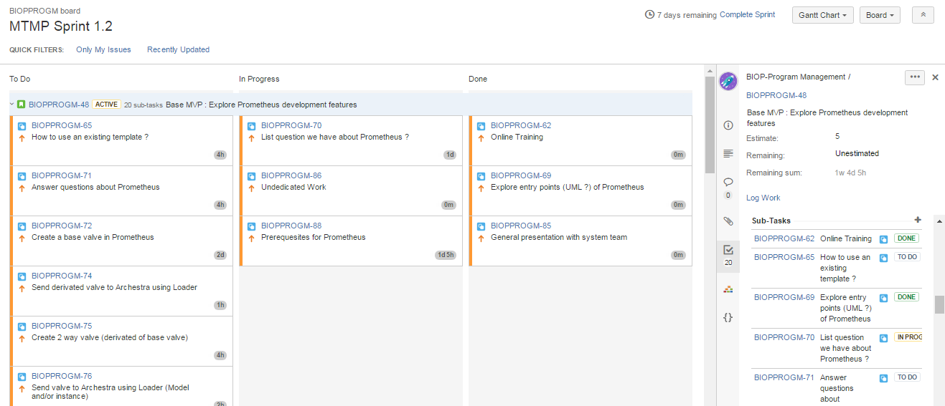
Create Sub-Tasks
Sprint Backlog completion
Sub tasks will appear under the corresponding User Story in your active Sprint
The related tasks are also displayed in the User Story detailed view

Slide 53
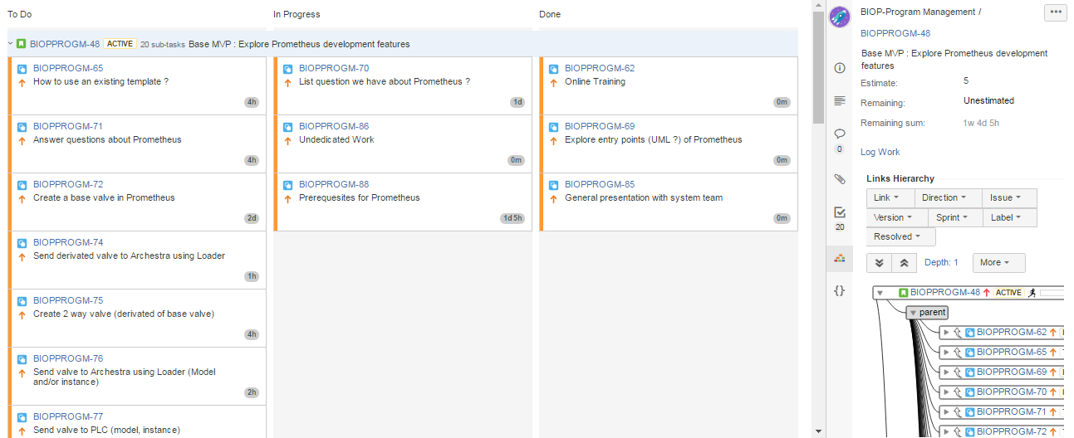
Create Sub-Tasks
Sprint Backlog completion
Link Hierarchy view is also displayed

Slide 54
Create Sub-Tasks
Sprint Backlog completion
You can access also to the Item complete view

Slide 55
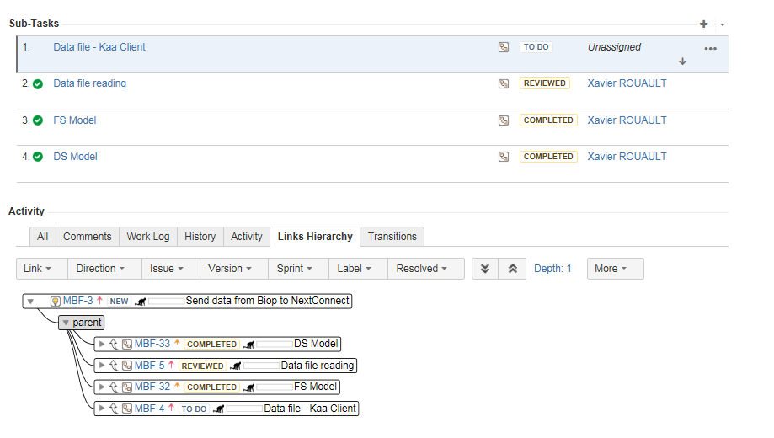
Create Sub-Tasks
Sprint Backlog completion
And retrieve all the links information
Sub Tasks completion progression is also visible through this view

Slide 56
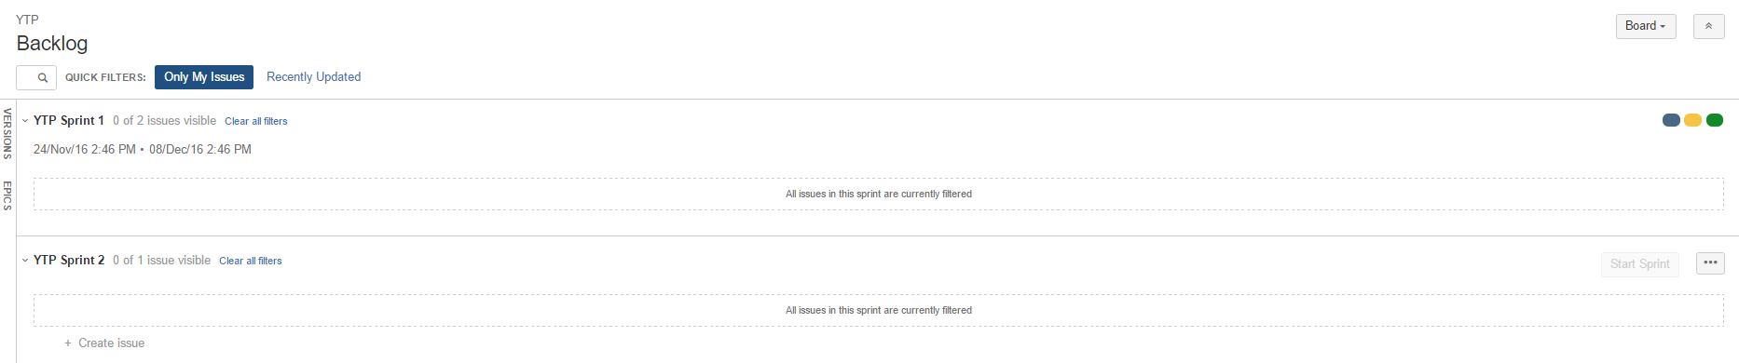
Search by filter
Sprint Backlog completion
Possibility to access to Product items by using quick filters
Items assigned to me

Slide 57
Step 7: Release version and archive

Slide 58
JIRA Step by Step
JIRA overview
JIRA
Sprint Planning
Sprint 1
Sprint 2
…
JAMA
Program Backlog
User Stories
Release planning
Program Backlog definition
Sprint Execution
Sprint Backlog
User Stories
Functional Specifications
Design Specifications
Release validation and archiving

Slide 59
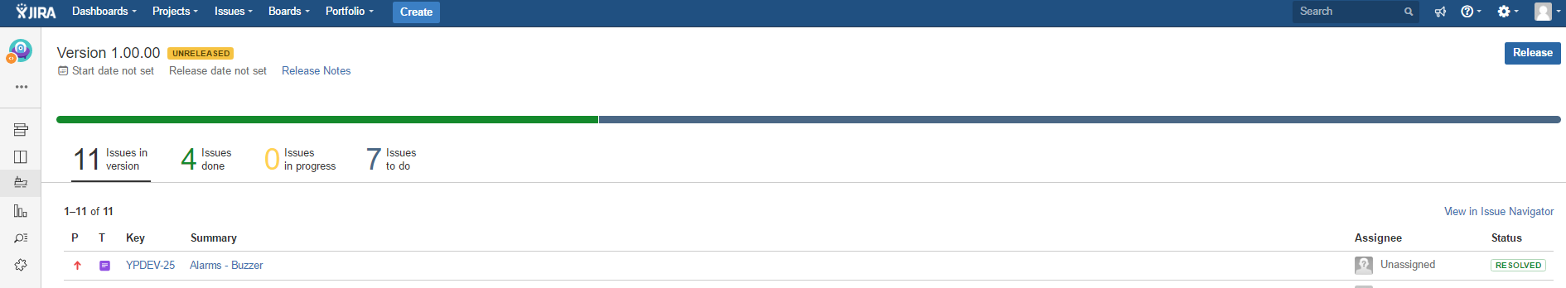
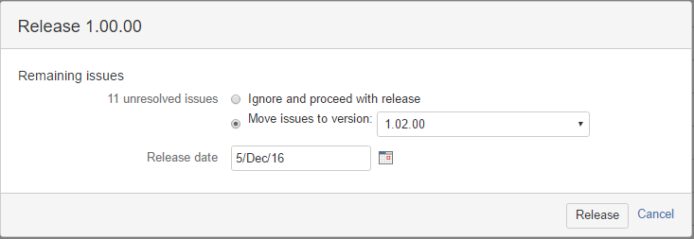
Release version and archive
Release version

Slide 60
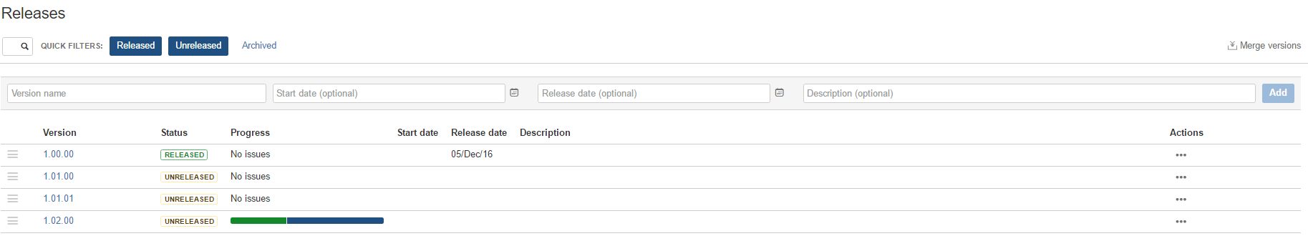
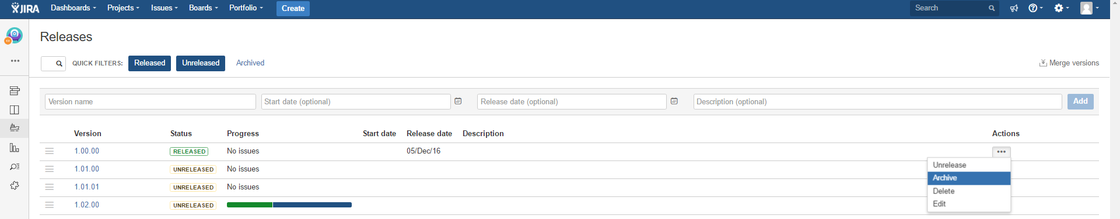
Release and Archive version
Release version and archive

Slide 61

Releases overviews
Release version and archive

Slide 62
Additional functionality : Reports

Slide 63

JIRA Reports
Reports

Slide 64


Burndown chart example
Reports

Slide 65

Question session
Thank you for your attention

